Slide 1

UNIT 7
THE WORLD OF WORK
(A4-B1,3,4)

Slide 2


1. New words:
UNIT 7 : THE WORLD OF WORK – A.4
typical /ˈtɪp.ɪ.kəl/ (adj)
keen /kiːn/ (adj)
lazy /ˈleɪ.zi/ (adj) :
period /ˈpɪə.ri.əd/ (n):
definitely /ˈdef.ɪ.nət.li/ (adv) :
review /rɪˈvjuː/ (v) :
điển hình, tiêu biểu
say mê
lười biếng > < hard-working
tiết học
chắc chắn , nhất định
ôn tập , xem lại

Slide 3

UNIT 7 : THE WORLD OF WORK – A.4
2. Read. Then answer the questions (A4- P.75).
Many people think that students have an easy life: We only work a few hours a day and have long vacations. They don’t know we have to work hard at school and at home.
Take a look at a typical grade 7 student like Hoa. She has five periods a day, six days a week. That is about 20 hours a week - fewer hours than any worker. But that is not all. Hoa is a keen student and she studies hard. She has about 12 hours of homework every week . She also has to review her work before tests. This makes her working week about 45 hours. This is more than some workers. Students like Hoa are definitely not lazy!

Slide 4
Answer the questions :
UNIT 7 : THE WORLD OF WORK – A.4
a. Why do some people think that students have an easy life ?
b. How many hours a week does Hoa work at school?
Is this fewer than most workers ?
c. How many hours a week does she work at school and at home?
d. Does the writer think students are lazy?

Slide 5


B1.Listen and Read
I. Vocabulary:
1. mechanic (n)
thợ máy
2. shift (n):
period of work: ca làm việc
3. (to) work part-time:
work for part of the day or week: làm thêm
4. day off :
a day on which you do not have to work: ngày nghỉ
5. homeless (adj)
vô gia cư

Slide 6

B1.Listen and Read: A letter from Tim Jones (Page 76)
July 3
Dear Hoa, I am pleased that you and your family are well. I am fine, too. Here is a photo of me, my Mom and Dad , and my sister, Shannon. Can you send me a photo of you? Let me tell you more about my parents. My Mom works at home. She takes care of the family. Three mornings a week, she works part - time at a local supermarket. She and other women also cook lunch for homeless people once a week. My Dad is a mechanic. He repairs machines in a factory. He works five days a week for about 40 hours, sometimes in the morning and sometimes in the afternoon. He prefers the morning shift. He has fewer days off than my Mom. However ,when he has an afternoon free, he plays golf. Dad gets about seven public holidays each year. He also has a three-week summer vacation. We always go to Florida on vacation. We have a great time and Dad plays more golf. Please write soon and tell me more about your family. Best wishes, Tim

Slide 7

Answer the questions:
Where does Mrs. Jones work?
b. What does she do for homeless people?
c. What is Mr. Jones’ job?
d. Does Mr. Jones have fewer days off than his wife?
e. How many hours a week does he usually work?
f. How do you know the Jones family likes Florida ?

Slide 8
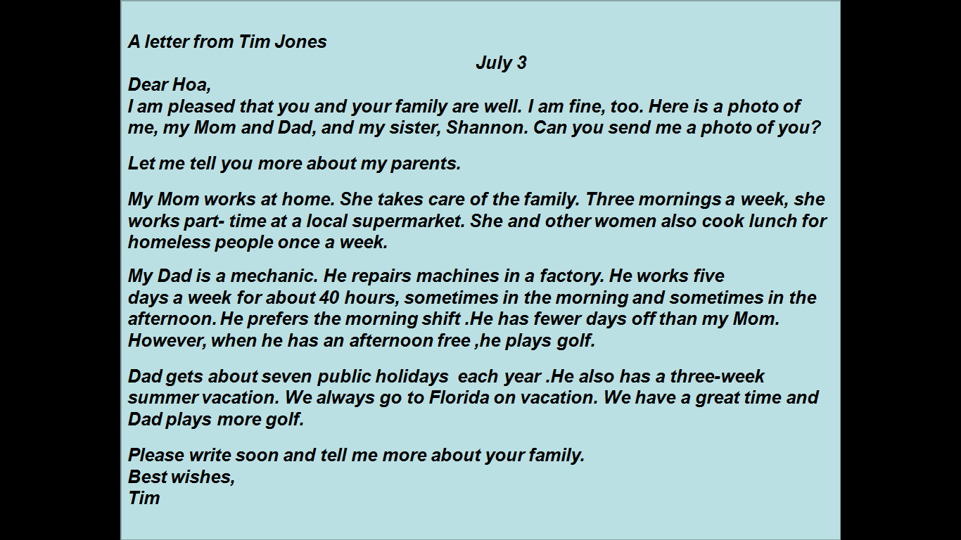
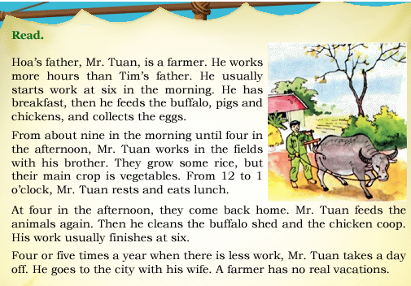
Read the letter from Tim Jones and the text about Mr Tuan. Then take notes about them
B3/ Compare

Slide 9
B4/ Listen and take notes:
Name
job
Hours per week
Amount of vacation
Peter
Susan
Jane
Phong

